Slide 1
Market Eye AI-Powered Stock Analysis System AI and Machine Learning Boot Camp : Graduation Project
</
/>
Team 6 members:
Mustafa Nizar
Maithah Waleed ALDhanhani
Reem Alzaabi
Amna Aljaberi
Khadija Alseiari
Heba Aljabri

Slide 2
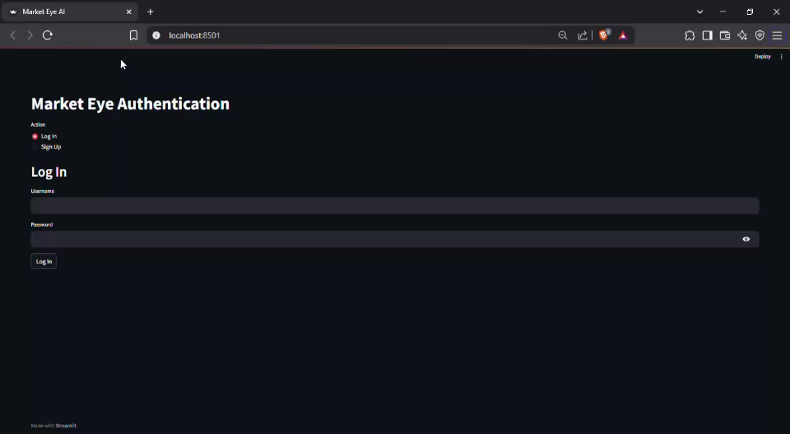
</Video

Slide 3
</Business problem overview:
General Description of the Project
You are part of the AI Development Team at VisionEdge, a financial consulting firm. In December 2024, your manager, Mr. Alex Carter, initiates a strategic project with a clear objective:
“We need a smarter way to understand the market and guide our clients with real insights. I want you to build an AI-powered system that collects stock data, forecasts prices for January 2025, generates investment recommendations using a Large Language Model (LLM), and evaluates these forecasts against actual market results. This will help us — and our clients — make informed, data-driven investment decisions and gain a competitive edge.”
This project aims to leverage AI technologies to automate stock analysis, enhance forecast accuracy, and deliver actionable recommendations, aligning with VisionEdge’s mission to provide innovative and insight-driven financial solutions.

Slide 4
</System architecture:
User
Streamlit UI
FastAPI Backend
SQLite Database
Forecast Chart
LSTM/MLP Model
PDF Reports
CrewAI Agents
LLM Recommendation
Gemini API

Slide 5
</Project & Backend Lead
Task in Team Division | Matches Which Step in AGF Doc? | Section/Page
Project Coordination (GitHub, timeline) | Step 8: GitHub & Version Control (Page 7) | Functional Req 8
User Authentication (sign-up/login) | Step 1: Database & User Management (Page 4) | Functional Req 1
Database Management (SQLite tables) | Step 1: users and activity_logs tables (Page 4) | Functional Req 1

Slide 6
</Data & Forecasting Engineer
Task in Team Division | Matches Which Step in AGF Doc? | Section/Page
Load/clean Kaggle dataset | Step 3: Dataset Integration (Page 5) | Functional Req 3
Daily data updates until Dec 2024 | Step 3: Automated pipeline (Page 5) | Functional Req 3
Train LSTM/MLP for Jan 2025 forecasts | Step 4: Forecasting Models (Page 5) | Functional Req 4
Compare forecast vs. actual (MSE/RMSE) | Step 4: Error metrics (Page 5) | Functional Req 4

Slide 7
</AI Agent Developer
Task in Team Division | Matches Which Step in AGF Doc? | Section/Page
Metric calculation (growth %, volatility) | Step 4: Analytics (Page 5) | Functional Req 4
Agent 1 (Data Collector) | Step 2: CrewAI Agent 1 (Page 4) | Functional Req 2
Agent 2 (Data Processor) | Step 2: CrewAI Agent 2 (Page 4) | Functional Req 2
Agent 3 (LLM Generator) | Step 2: CrewAI Agent 3 (Page 4) | Functional Req 2
Agent Orchestration | Step 2: Deployed agents (Page 4) | Functional Req 2

Slide 8
</Frontend & LLM Specialist
Task in Team Division | Matches Which Step in AGF Doc? | Section/Page
Streamlit UI (login, dashboard, charts) | Step 5: Streamlit Frontend (Page 6) | Functional Req 5
Gemini API integration | Step 7: LLM Integration (Page 7) | Functional Req 7
PDF Reporting | Step 6: PDF Report Generation (Page 6) | Functional Req 6

Slide 9
</Lessons learned and challenges:
Lessons learned:
Database & User Management
Challenges :
The project it self because it was first time.
The idea of connect different code and make it work as on thing.
Deadline/project file representation

